Slide 1
Performance issue in sending bulk emails

Slide 2
About problem
When we send the bulk emails it takes a lot of time to revert back the success/confirmation message.

Slide 3
In depth explanation
For example, if we make an announcement and let's say we broadcast it to 100 employees, then it takes approximately 40s to publish that announcement. This problem might be everywhere in the software where we send bulk emails.

Slide 4
Technical explanation
We are sending emails one person at a time. That is first we send email to one person then to second and so on. Technically we are sending email in a loop (basically for loop) at backend. Therefore it takes a lot of time to get acknowledged.

Slide 5
Proposed Solutions

Slide 6
Solution 1 (Multithreading)
Multiple threads can be used to send emails parallelly. Multithreading might result in significant decrease in time. Probably we can send 2000 emails in less than 15 seconds.

Slide 7
Solution 2
We can acknowledge to the user first and publish it on the front end, then we can start sending emails in loop.

Slide 8
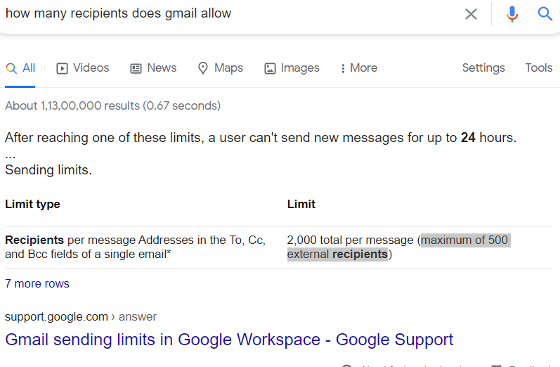
Solution 3
We can add 500 recipients at a time while sending email to a person.

Slide 9
Thank You
Made By: Sameer Sharma

